Slide 1
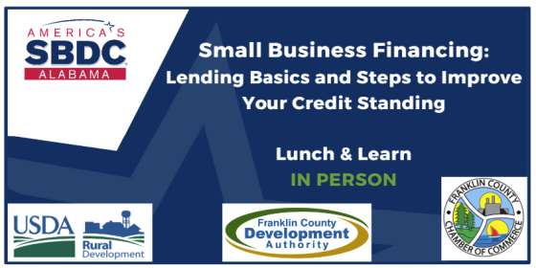

Slide 2

As the largest statewide provider of entrepreneurial and business development services,
Alabama SBDCs play a vital role in Alabama’s economic development by assisting entrepreneurs in every stage of the business life cycle.

Slide 3
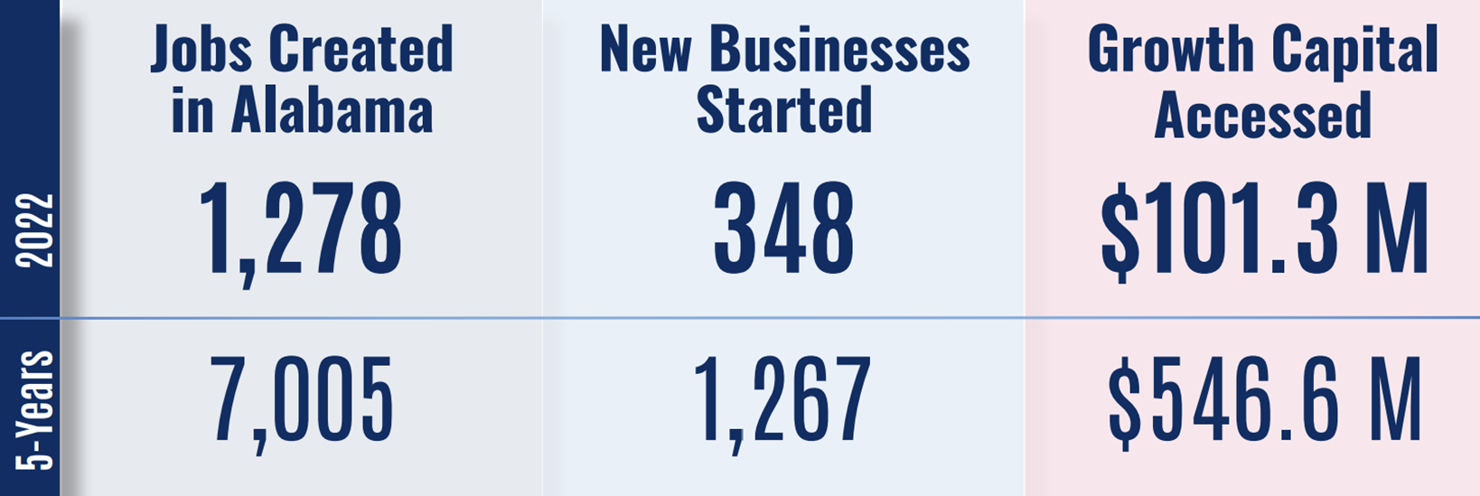
Impact/Results

Slide 4
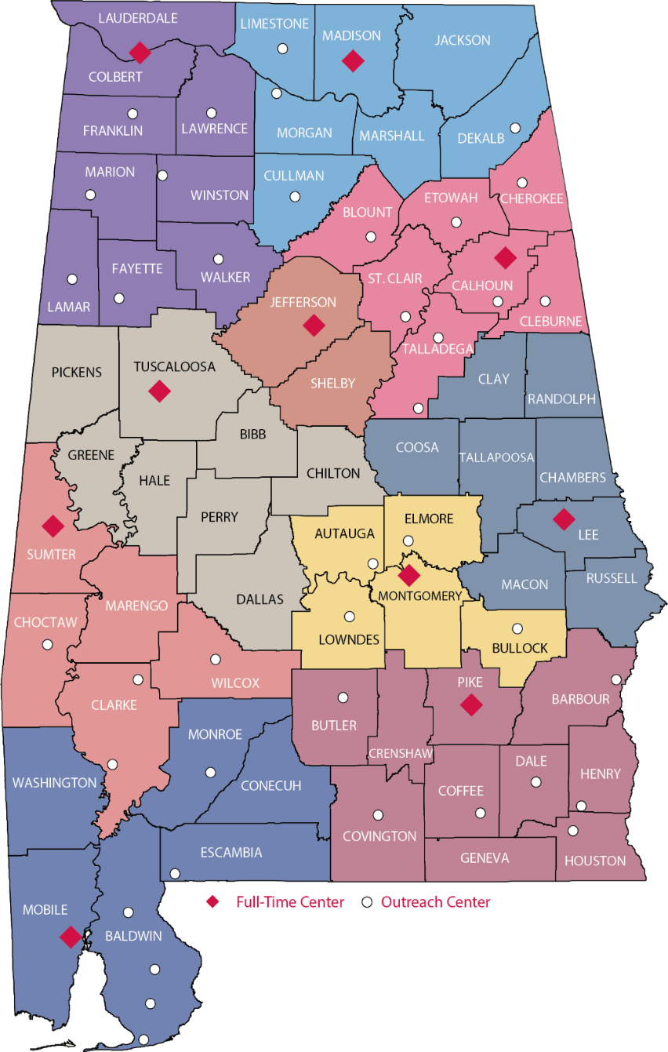









Alabama SBDC Network
10 Full-Time Service Centers, 40 Outreach Locations
Notes:
10 Full Time location, primarily at 4yr institutions,
40 outreach locations: not full time, but frequent visit with local partner, such as chambers, incubators, developers, etc.
Survey

Slide 5
Lending

Slide 6
Equity Investors
Friends, Family
High Net Worth Individuals
Angel Investors
Venture Capital
Private Equity
Trade Partners
Tax Credit Investors (New Market Tax Credits; Historic Tax Credits)
Other Public Equity (grants; in-kind services; etc.)

Slide 7
Debt Investors
Friends and Family
Trade Partners
Bank – traditional debt
“Credit enhanced” bank debt (USDA, SBA, ADECA, AlabamaSAVES, SSBCI)
Council of Governments Revolving Loan Funds
CDFI Debt
Energy Cooperative’s Revolving Loan Funds
Private Equity

Slide 8
Alternative Funding
Pitch Competitions (Alabama Launchpad, Tiger Cage, etc.)
Private Sector Grant Competitions (FedEx Small Business Grant Contest, Nav’s Small Business Grant, Amber Grants for Women, etc.)
Grants (https://www.asbdc.org/start-your-business/alabama-grants-for-small-businesses/)
  Unless your business involves the development of new technology or is a non-profit organization, it is difficult to find a grant to start or expand a small business.
Incentives

Slide 9

What does a lender look for in a loan application?
Hint: It is not a business plan.

Slide 10
Five Cs of Credit
The five Cs of credit are used by lenders to gauge the creditworthiness of potential borrowers.
Character: the applicant’s credit history.
Capacity: the applicant's debt-to-income ratio.
Capital: the amount of money an applicant has.
Collateral: an asset that can back or act as security for the loan.
Conditions: the purpose of the loan, the amount involved, and prevailing interest rates.

Slide 11
Lender Minimum Requirements
Experience: Relevant management experience in the industry.
Secondary Source of Income: This can be a spouse’s income, an affiliate business’ income, or the applicant keeping their job until the business is off the ground.
Credit History: A demonstrated record of paying bills on time; no active collections, no charge offs, not in bankruptcy, minimal or no late payments.
Equity Injection: A lender will need to see at least 10% of project costs available as cash for businesses that do not have two years of tax returns.
Current on Taxes and Child Support: Current or making payments under a payment plan.

Slide 12
Document Requirements for Startups
For any owner of 20% or more of the business:
  Complete Personal Financial Statement, joint with spouse
    Why ask for spouse if the spouse is not on the loan? A lender is looking at total household income.
  Last 3 years of personal tax returns
  Credit report, for the applicant and spouse
  Management resume
Project expense summary – outline the uses of funds
Start-Up Projections

Slide 13
Personal Financial Statement (PFS)
Are they current on their payments?
Do they have cash available for an equity injection? If not, where will they get it?
What are the terms of business debt? Will it be refinanced with new debt?
Do they have equity in their home or other real estate?
* Only personal information – no business

Slide 14
Start-Up Projections for Startups
What are they?
  Financial projections use existing or estimated data to forecast your business' future income and expenses
What do they include?
  Sources & Uses of New Capital
  Revenue Assumptions
  Expense Assumptions

Slide 15
Document Requirements for Existing Business or Business Purchase
Same documents from previous slide, plus:
  Last 3 years of business tax returns
  Interim business financials (P&L and Balance Sheet)
  Business debt schedule

Slide 16
What does a lender do with these documents?

Slide 17
Global Cash Flow Analysis

Slide 18
The Purpose of a Global
Will there be enough cash available to cover the loan payment?
Shows Income to debt ratio (debt service coverage ratio)
  > 1.25, both before AND after new debt (for every dollar of debt, there’s a $1.25 of income)
Shows debt-to-income ratio
  < 40% (debt, including new debt, makes up no more than 40% of household income)
A perfect global doesn’t mean the project is a homerun, but it means the minimum requirements are met.

Slide 19
Analyze GLOBALLY – Personal (Joint w/Spouse) and Business
Income comes from personal & business tax returns, interim financials, PFS
If someone is quitting their job to work in a new business, do not include their current salary.
Debt comes from credit reports, Business Debt Schedule.
Amount the client is seeking, per the Business Summary
We are looking for a debt coverage ratio of at least 1.25

Slide 20
Additional Items
Needed for Loan Package
Resume
Business Plan
Projections Supported by Assumptions

Slide 21
Credit Scores

Slide 22
What is Credit?
Credit is the ability to borrow money or access goods or services with the understanding that you will pay it back later.
It allows individuals and businesses to make purchases or investments without having to pay the full amount upfront.
Notes:
Credit allows small business owners to access capital for growth and expansion.
Good credit enables entrepreneurs to secure loans and financing at favorable interest rates.
Having a strong credit history can attract investors and partners.
Creditworthiness affects business relationships and opportunities for collaboration.
Hard to get auto loans etc

Slide 23
Credit Comparison
Business Credit
Personal Credit
Equifax, Experian, and Dun & Bradstreet
Connected to you by your EIN or Tax ID Number
Scores have many different ranges
Hard to obtain as a start-up business
Equifax, TransUnion, and Experian
Connected to you by your SSN
Scores range from 300 to 850
Your personal credit score and report are very important for obtaining business lending
Notes:
You need good personal credit
Buildinng business credit-credit cards with vendors

Slide 24
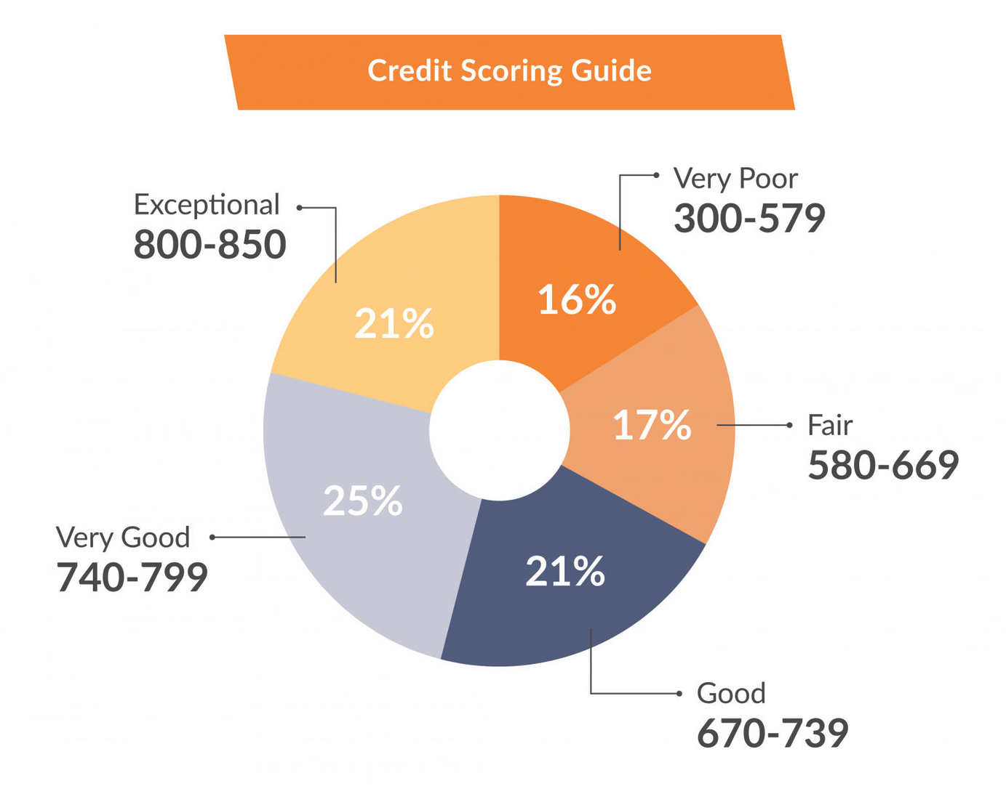
Credit Score Ranges
Notes:
Credit score Ranges
Range
600 or higher for lending
CreditKarma

Slide 25
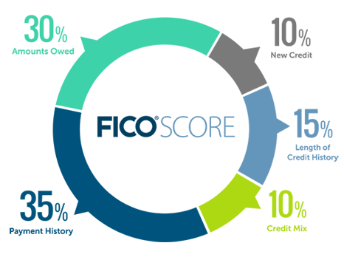
How is your credit score calculated?
Notes:
Payment History
The consistency of making payments on time every single month
Credit report has 30,60,90 days past due. And can stay that way for months unti you get caught up. Single biggest impact on credit score
Can ddop your score over 100 points
How long do they stay on your account?
Amounts owed- credit utilization and do you owe a lot compared to your outstanding balance
tally your outstanding debt across all revolving credit accounts.
Reducing your revolving credit balances; Increasing your credit limit. 30% or lower
For example if you have credit limit of $10,000, how much of that have you used?
What credit utilization rate do you want to stay below?
Length of history- bank perspective, the longer you have accounts open in theory the longer you have consistently been paying on time which is viewed well
Credit mix- do you have credit cards, auto loans, mortgage?
What do you think you have the most control? Which area if you changed habits or made changes to would be impactful to our score?

Slide 26
Which scenario shows more trustworthiness?

Slide 27
Payment History (35%)
Scenario A
Jordan pays his utility bills on time but occasionally forgets about his store credit card bill.
VS
Scenario B
Taylor sometimes waits until the last minute but has set up automatic payments for all her credit accounts to ensure they're paid on time.
Notes:
1. Payment History
Answer: Scenario B (Taylor) is more favorably viewed by lenders.
Explanation: While both Jordan and Taylor might occasionally be late or wait until the last minute, Taylor's use of automatic payments ensures that her bills are always paid on time. Consistent on-time payments are crucial for a favorable payment history.

Slide 28
Amounts Owed(30%)
Scenario A
Casey has three credit cards. Two of them are almost maxed out, but one has no balance at all.
VS
Scenario B
Alex has two credit cards. He uses both regularly but pays off large chunks every month, keeping the balance around 40% of the limit.
Notes:
2. Amounts Owed (Credit Utilization)
Answer: Scenario B (Alex) is more favorably viewed by lenders.
Explanation: While Casey has one card with no balance, having two cards nearly maxed out can be concerning to lenders. Alex, on the other hand, maintains a balance but ensures it's around 40% of the limit, which is better than being nearly maxed out.

Slide 29
Length of History
(15%)
Scenario A
Jamie has had a department store credit card for 15 years but rarely uses it. She opened a general credit card two years ago and uses it frequently.
VS
Scenario B
Riley has had two credit cards and a car loan, all opened within the last five years.
Notes:
3. Length of Credit History
Answer: Scenario A (Jamie) is more favorably viewed by lenders.
Explanation: The length of credit history is determined by the age of your oldest account, the age of your newest account, and the average age of all your accounts. Jamie's department store card, which has been open for 15 years, gives her a longer credit history than Riley.

Slide 30
New Credit(10%)
Scenario A
Sam was shopping for a car and had his credit checked at four different dealerships within a week.
VS
Scenario B
Morgan applied for a new credit card 3 months ago and recently inquired about a personal loan.
Notes:
4. New Credit (Credit Inquiries)
Answer: Scenario B (Morgan) is more favorably viewed by lenders.
Explanation: While both scenarios involve multiple inquiries, Sam's multiple credit checks in a short time for the same type of loan (auto loan) can be seen as rate shopping and might be treated as a single inquiry. However, frequent credit checks for different credit types within a short period, as in Morgan's case, are less likely to be grouped together, making it slightly less favorable. It's a close call, but frequent diverse inquiries can be seen as potential financial desperation.

Slide 31
Types of Credit (10%)
Scenario A
Chris has a mortgage and recently opened a new credit card for a store he frequently shops at.
VS
Scenario B
Jordan has a student loan, a car loan, and one credit card she uses for emergencies.
Notes:
5. Types of Credit Used
Answer: Scenario B (Jordan) is more favorably viewed by lenders.
Explanation: Lenders like to see a mix of different types of credit, as it indicates that the borrower can handle various credit responsibilities. Jordan has a more diverse mix with a student loan, car loan, and a credit card, compared to Chris, who only has a mortgage and a store credit card.

Slide 32
Credit Reports

Slide 33
Understanding Credit Reports
A credit report is a detailed record of an individual's credit history, including their borrowing and repayment activities.
Components of a credit report include personal information, credit history, public records, and inquiries.
Understanding credit reports is essential for managing and improving credit health.

Slide 34
Free Credit Report
https://www.annualcreditreport.com/index.action

Slide 35
Reading your Credit Report

Slide 36
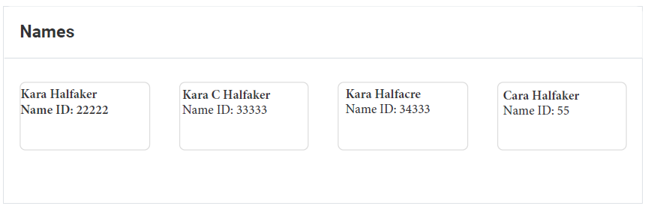
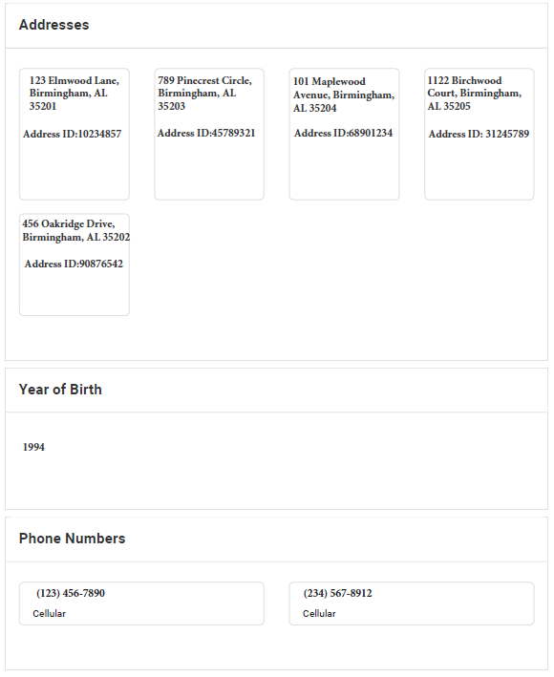
Your Information
Mismatched Names: Names you don't recognize or have never used.
Incorrect Social Security Number: Even a slight variation can be a red flag.
Unfamiliar Addresses: Addresses where you've never lived or conducted business.
Wrong Date of Birth: A simple error or potential identity theft sign.
Notes:
Listed name variations and aliases
• Any different SSN reported by creditors
• Past and current addresses
• Year of birth
• Past and current employers
• Past and current telephone numbers

Slide 37
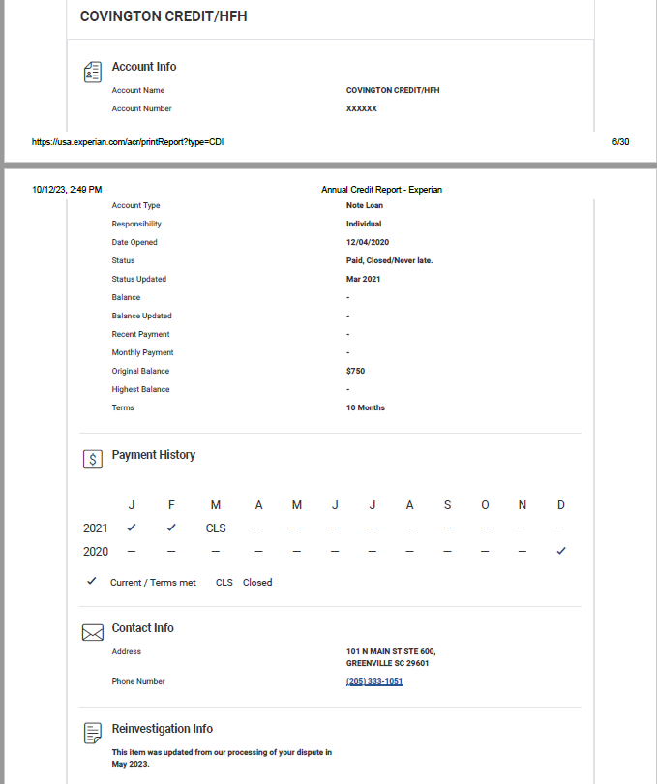
Your Accounts
Accounts that aren't yours.
Payments marked late when you paid on time.
Incorrect account balances.
Old debts that should have been removed due to the statute of limitations.
Duplicate listings of the same debt or account.
Notes:
Closed accounts reported as being open
• Incorrectly reported as late or delinquent
FREE CREDIT REPAIR COURSE www.creditdeputies.com
15
• Incorrect dates of last payment or date opened
• Same debt listed more than once
• Incorrect balance amounts

Slide 38
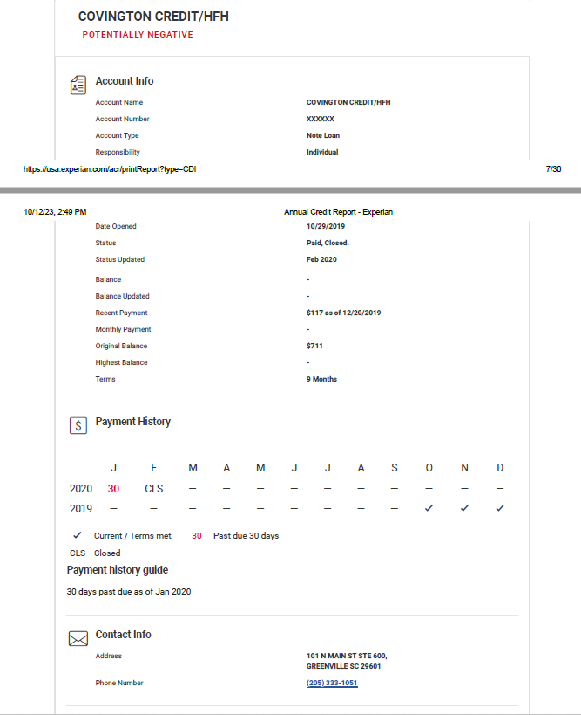
Potentially Negative Accounts
Unknown Judgments
Unfamiliar Bankruptcies
Tax Liens You Didn't Know About
Closed Accounts Reported as Open
Accounts Listed as "Default" or "Delinquent“
Wrong Account Dates
Notes:
Unknown Judgments: Legal decisions against you that you're unaware of.
Unfamiliar Bankruptcies: If you didn't file for bankruptcy but it appears on your report.
Tax Liens You Didn't Know About: These are claims by governments for unpaid taxes.
Closed Accounts Reported as Open: Especially if you've closed them yourself.
Accounts Listed as "Default" or "Delinquent": If you've been making timely payments.
Wrong Account Dates:

Slide 39
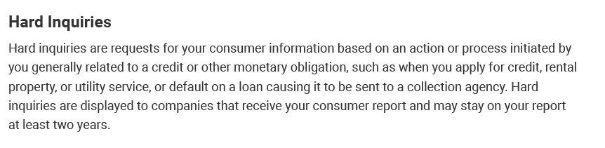
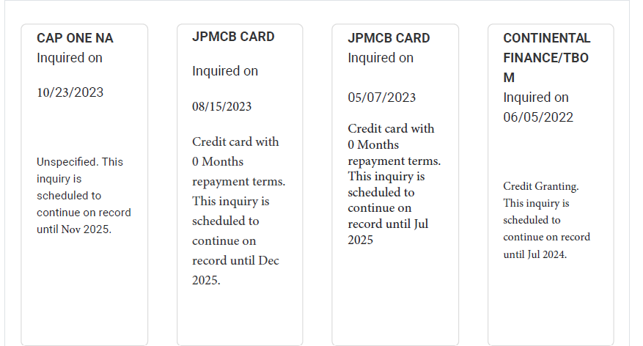
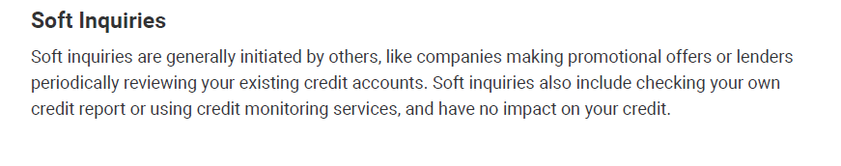
Hard & Soft Inquiries
Multiple Inquiries in a Short Time: Especially if you didn't apply for credit multiple times.
Inquiries from Unknown Companies: Companies you don't recognize or didn't do business with.

Slide 40
Credit Repair

Slide 41
Repairing Credit
Checking Credit Report for Errors
Setting up Payment Reminders
Reducing Debt
Dispute Errors

Slide 42
Disputing Errors
Gather Evidence:
Collect any proof that supports your claim, such as bank statements or payment confirmations.
Write a Dispute Letter:
Clearly explain the error and provide evidence. There are many templates available online to guide you.
Send the Letter to the Credit Bureau(s):
It's recommended to send it via certified mail with a return receipt request. This provides proof that your letter was received.
Wait for a Response:
The credit bureau typically has 30 days to investigate and respond
Notes:
Negative items within the last 2 years (24 months from the date the account became derogatory) have the most impact to your credit score.
• Focus on the accounts that became negative recently, within the last 2 years, if you want to raise your credit score. o Exception To This Rule: When an account has more than (3) 30-day late payments or when an account is 120 days late or more.

Slide 43
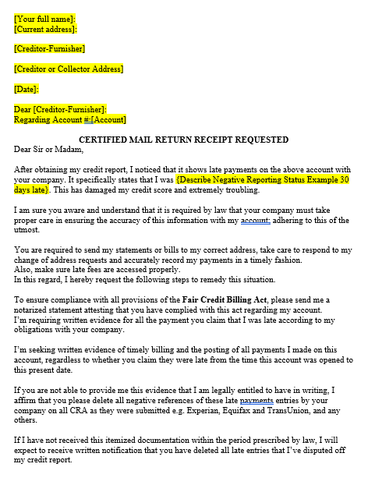
Example of Letter
Using ChatGPT to help you

Slide 44
Paying Down Debt
- Snowball Method
- Avalanche Method
- Negotiating with Creditors
Notes:
Focus on high-interest debts first or consider strategies like the snowball method (paying off small debts first).
Some may be willing to settle for less than what you owe or change the status of the account in exchange for payment.
For each method, predict the order that the debts will be paid off.
Which method do you think will cost the least amount of total interest when all debts have been repaid?
Which method do you think will pay off all debts in the least amount of time?

Slide 45
Paying Down Debt
Which Debt would you focus on first?
Snowball Method
Avalanche Method
Debt Type | Amount | Interest Rate | Monthly Payment
Credit Card 1 | $5000 | 26.9% | 3% of balance
Credit Card 2 | $2950 | 8.25% | 3% of balance
(Private) Student Loan Debt | $25,745 | 10.5% | $347
Vehicle Debt | $10,392 | 4.61% | $310
Mortgage Debt | $100,197 | 3.44% | $447
Notes:
Focus on high-interest debts first or consider strategies like the snowball method (paying off small debts first).
Some may be willing to settle for less than what you owe or change the status of the account in exchange for payment.
For each method, predict the order that the debts will be paid off.
Which method do you think will cost the least amount of total interest when all debts have been repaid?
Which method do you think will pay off all debts in the least amount of time?

Slide 46
Build Positive Credit Habits
Pay Bills On Time
Reduce Credit Utilization
Avoid Opening Too Many New Accounts Keep Old Accounts Open
Notes:
Your payment history is a significant factor in your credit score.
Try to use less than 30% of your available credit. For example, if you have a credit card with a $10,000 limit, try to keep the balance below $3,000.
Avoid Opening Too Many New Accounts: Each new credit inquiry can slightly reduce your credit score.
Keep Old Accounts Open: The length of your credit history contributes to your score. Even if you don't use an old credit card, keeping it open can benefit your credit score.

Slide 47
Monitor Your Credit
Regularly checking your credit report can help you catch errors or signs of identity theft early.
Download your free credit reports once a year

Slide 48
Alabama SBDC Network
ASBDC.org kara@sbdc.org
Register Online at
www.asbdc.org/register
Workshops and Webinars
bit.ly/asbdcprograms
Drop Box Link: bit.ly/capitaltraining2024

